Slide 1
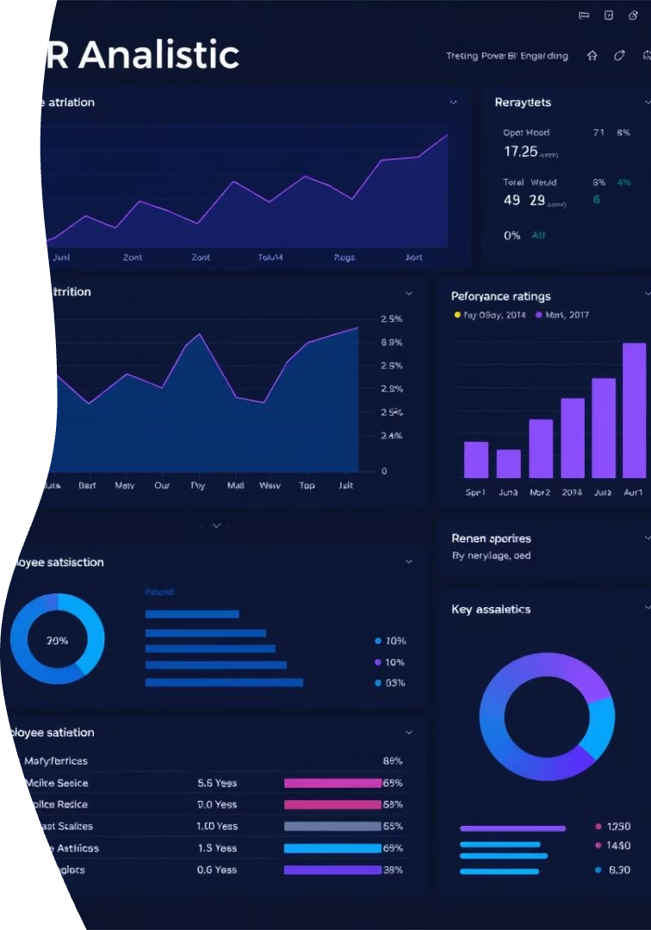

IBM HR Analytics Dashboard
Unlocking insights from HR data to drive strategic talent management.
NT
by
Niket Talikoti

Slide 2

Project Objective
Understand Attrition Patterns
Analyze Key Factors
Explore demographics, satisfaction, job roles.
Identify trends in employee departures.
Enable Data-Driven Decisions
Support HR in reducing turnover.

Slide 3
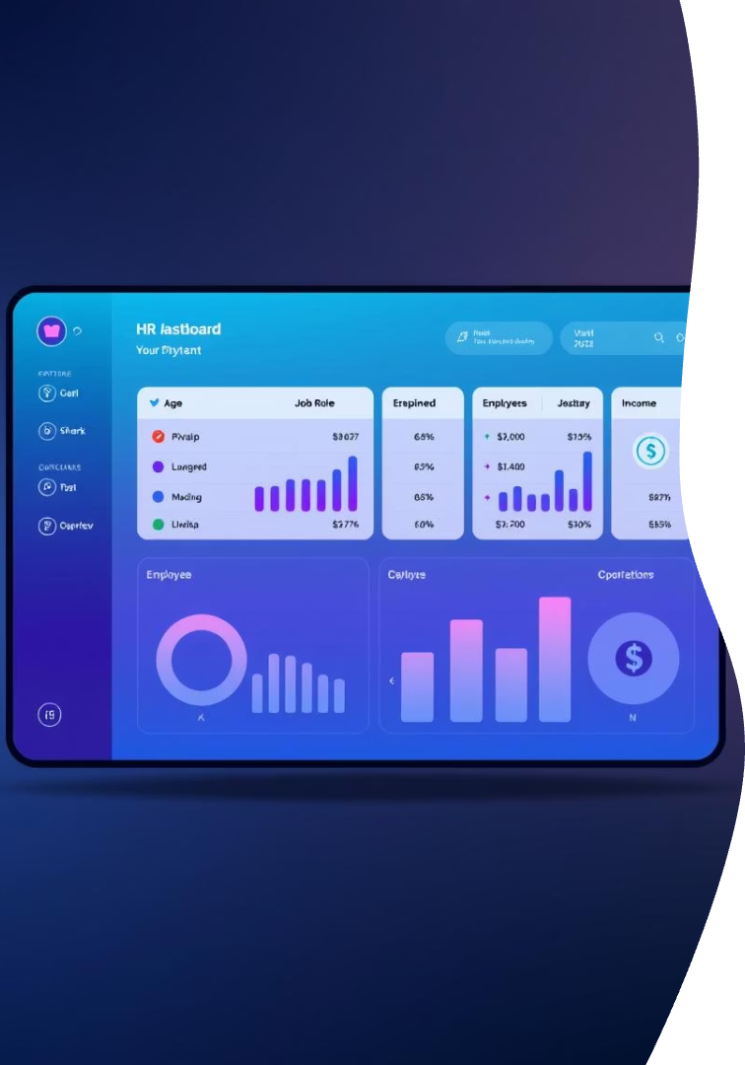
Dataset Overview
Records
1,470 Employees
Features
35 Attributes
Demographics
Age, Gender, Job Role
Financial
Monthly Income
Work Factors
Distance, Work-Life Balance
Performance
Satisfaction, Ratings

Slide 4
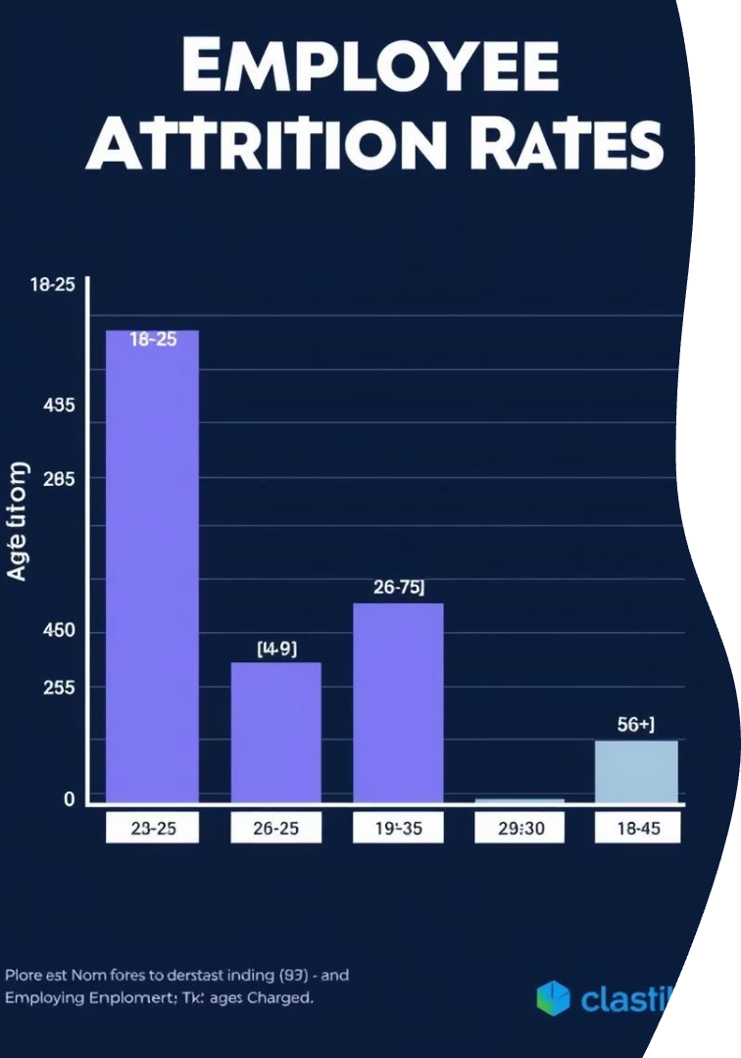
Attrition Overview
16.12%
7.01
Attrition Rate
Avg Tenure
Overall employee turnover.
Years employees typically stay.
26-35
Age Group
Highest attrition occurs here.

Slide 5
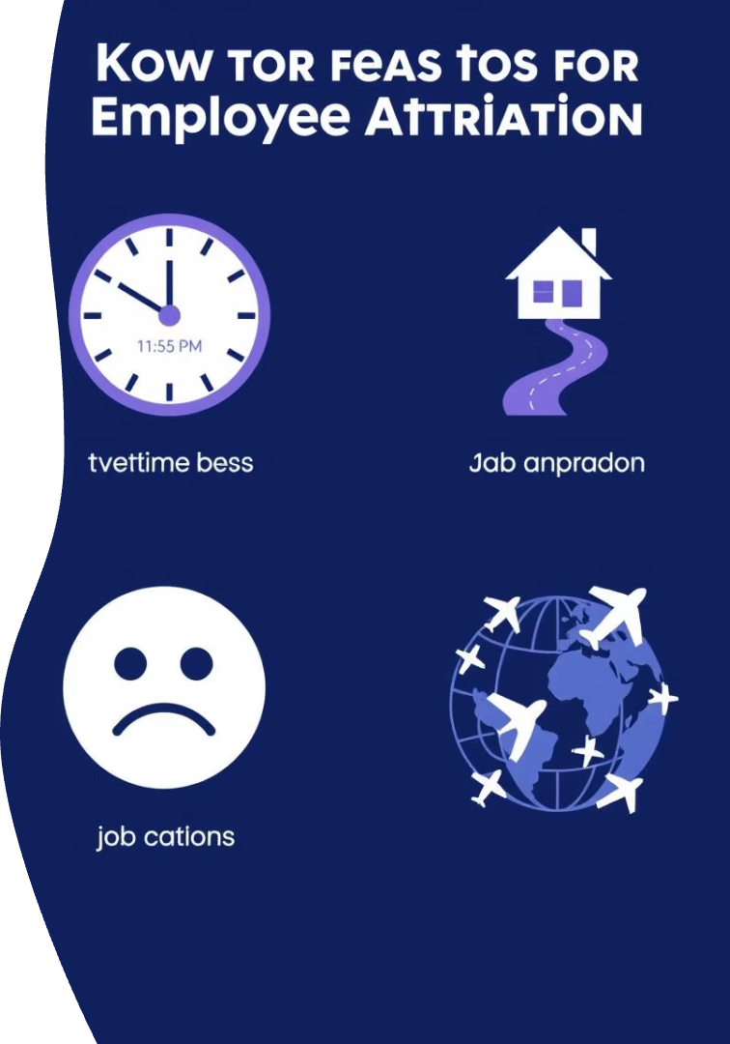
Key Drivers of Attrition
Overtime
High correlation with attrition.
Distance from Home
Longer commutes increase turnover.
Low Job Satisfaction
Unsatisfied employees tend to leave.
Work-Life Balance
Poor balance drives attrition.

Slide 6
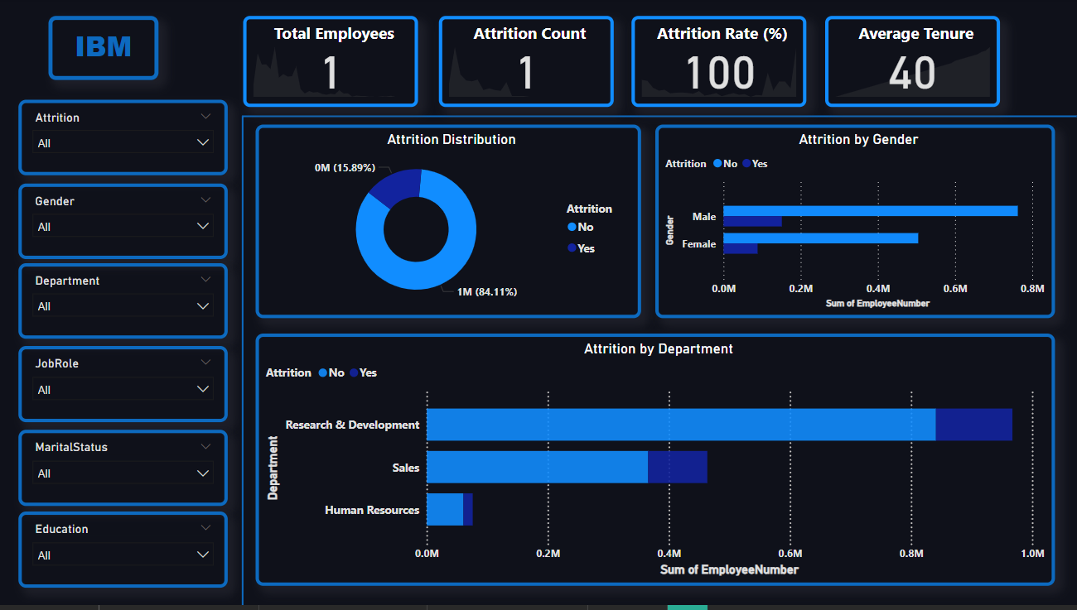
Demographic Insights

Slide 7
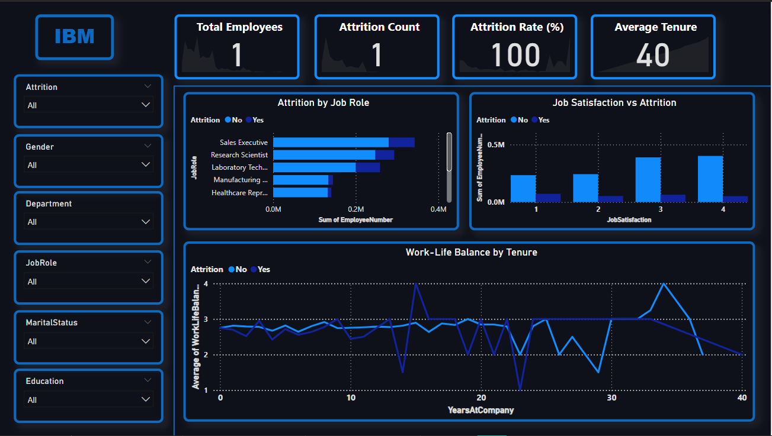
Demographic Insights

Slide 8
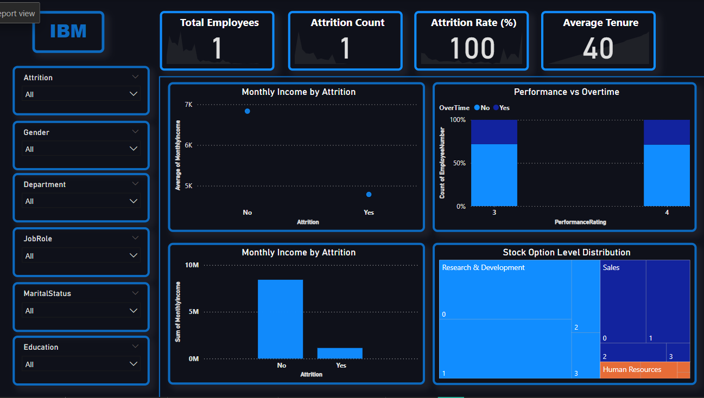
Demographic Insights

Slide 9
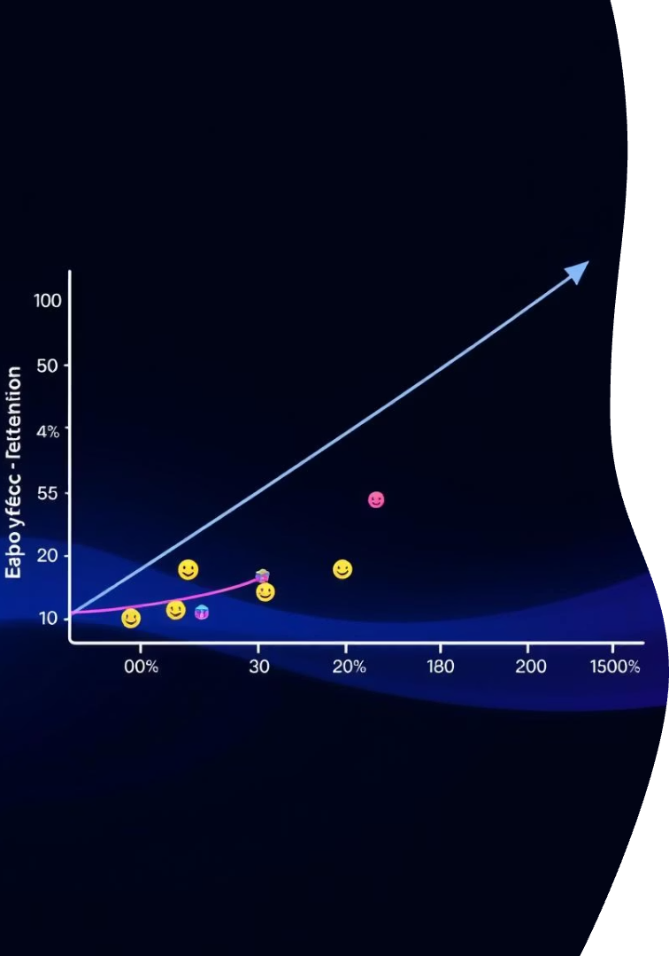




Performance & Satisfaction Analysis
Low Satisfaction
Direct link to higher attrition.
Poor Work-Life
Impacts retention negatively.
Fewer Stock Options
Reduced incentive to stay.
High Performers
Tend to remain longer.

Slide 10
Recommendations
Staffing Adjustments
Work-Life Policies
Relocation Support
Engagement Programs
Reduce overtime burdens.
Enhance employee well-being.
Offer hybrid work options.
Focus on Sales & R&D.
Incentivize Retention
Provide stock options, growth.

Slide 11

Strategic Next Steps
1
Implement Policies
Launch new HR initiatives.
2
Monitor Impact
Track attrition and satisfaction.
3
Iterate & Improve
Adjust strategies based on data.

Slide 12
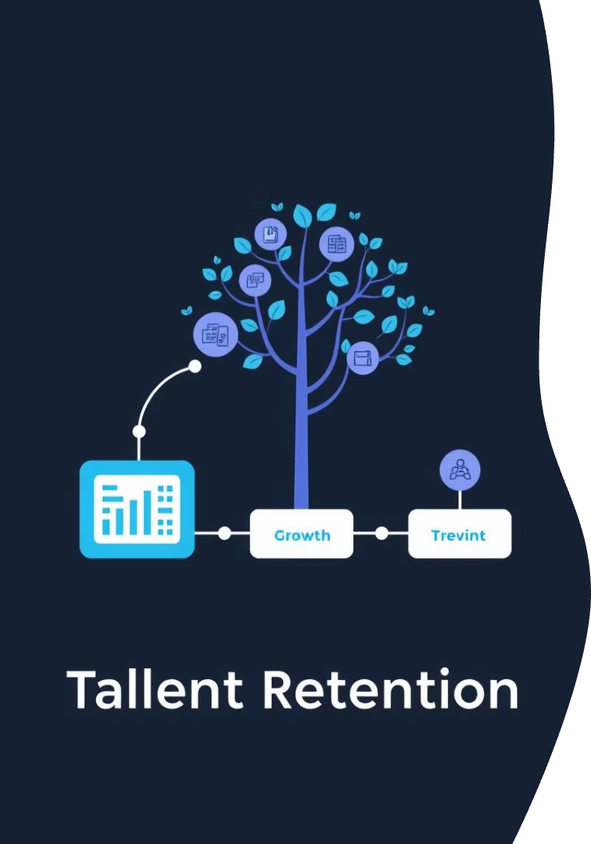
Conclusion
At first glance, the company seemed stable, but the data revealed otherwise. Our Power BI dashboard showed that over 16% of employees had left, with Sales Executives and R&D roles most affected. OverTime was a major red flag, as even high performers were leaving, signaling burnout. While higher pay helped, low job satisfaction and poor work-life balance were stronger attrition drivers. Younger employees and women had slightly higher exit rates, raising cultural and equity concerns. In the end, attrition wasn’t just a number—it was a call to improve employee experience, not just increase compensation.

Slide 13

THANK YOU

